Slide 1

How to Get Money!
By: Allocations Board

Slide 2
WHO ARE WE?
We are the Allocations Board (A-Board)!
Seven members:
Ari Ben-Elazar (Co-chair), Judy Nam (Co-chair), Andrew Miller (Treasurer), Jon Jacob, Elad Ohayon, Annie Li, and a member from the Senate (TBD)
We allocate funds to clubs through requests made during marathons
We are NOT the Treasury!
The Treasury dispenses the funds
Reimbursements, checks, cash advances, P-Card

Slide 3
AGENDA
Types Of Marathons
Tutorial: Signing Up For Marathon
Funding Policy
Tutorial: Requesting Funds
Questions?

Slide 4
TYPES OF MARATHONS
Regular Marathon (Beginning of semester)
Funding for the majority of the current semester
Early Marathon (End of semester)
Funding for beginning of following semester
Full Marathon (New!)
Funding for full year (e.g. instructor fees)
Appeals (~2 weeks after Regular/Early Marathon)
Emergency Request Meetings (At A-board discretion)
Unexpected costs for events ALREADY REQUESTED

Slide 5
WHAT TO DO AT MEETINGS
Marathon sessions are opportunities to help you explain your event costs; they aren’t mandatory
BE PUNCTUAL!!!
Sign up for marathon ASAP
Arrive 15 minutes early and be prepared to stay late
Expect questions regarding the necessity of your requests
Relax: we’re here to help! ☺
Notes:
Example: Wednesday and Thursday full, one club on Sunday and a handful of clubs on Monday

Slide 6
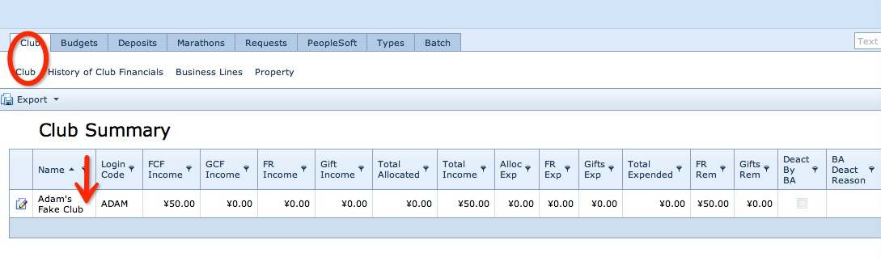
WHERE TO SIGN UP
Go to brandeisweb.com (SUMS) and sign in (if unknown, email clubfinance@brandeis.edu)
Go to the tab “Club” then the subtab “Club”
Under “Club Summary,” click the pencil icon next to your club name to edit your club information

Slide 7
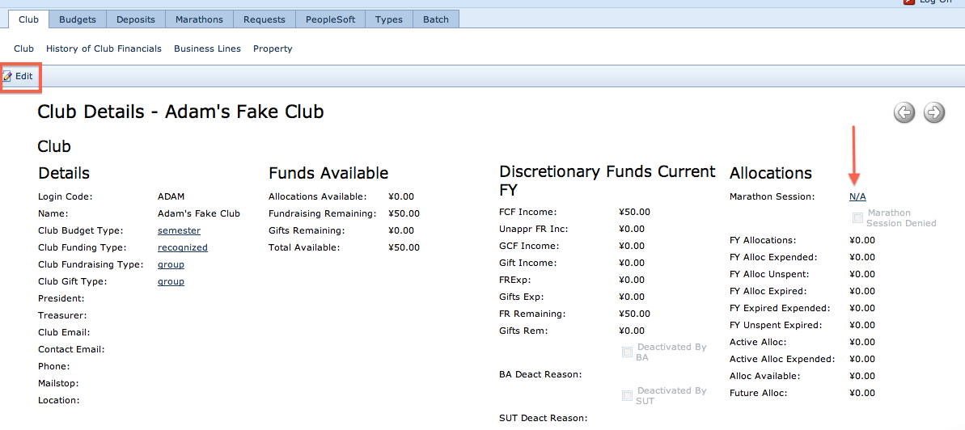
HOW TO SIGN UP
Under Allocations, go to Marathon Session and click the drop-down list to sign up for a time slot.
Complete the Club Details on the left (President, Treasurer, emails, phone, mailstop). We will not meet with you unless this is filled out.
Click “Save and Close.”

Slide 8
FUNDING POLICY
Defines what CAN and CANNOT be funded
Please be aware that Treasurers will NOT approve requests made outside of the Policy
Only secured and chartered clubs are eligible to request and receive funds (as stated in the Constitution and the By-Laws of the Student Union, )
A-Board funds originate from the Student Activity Fee (SAF), which is set at 1% of the Brandeis tuition
Last year, the SAF for each student was $480 ($240 per semester)

Slide 9

RESTRICTED ITEMS
Fundraising Costs
e.g. A-board can’t fund club swag you’re going to sell
The Undergraduate Theater Collective (UTC) Fee
Alcohol

Slide 10
RESTRICTED ITEMS cont.
Political Campaigning
Campaigning for a specific political party or member of a party for any public office is not allowed due to Brandeis’s non-profit status.
Campaigning for a specific law, however, is permitted
Personal Properties
Items that will not be kept by the club but rather distributed to individuals.
Retroactive Requests
You cannot ask for funding for an unapproved item you bought for a previous event

Slide 11

FINANCIAL MISCONDUCT ☹
Defined as using SAF money for any expenditure not approved by A-Board (e.g. buying supplies for events that were not specified at Marathon, buying items that were denied funding by A-board, overspending)
All reimbursements and future funding will be withheld until an agreement can be made with the Treasurer, A-Board, and the violating parties

Slide 12

REQUIRED FORMS
Cost Estimates
At marathon or e-mail to clubfinance@brandeis.edu
Public Safety (Ed Callahan)
Conference and Events Services (CES) (Kimberly Callahan)
Escort Services (Rupert Thomas Jr)
>> Jump Start Meetings
Monday @ 3:00 PM in SCC 315
Notes:
Public Safety (Ed Callahan)
Police officers for large events
Conference and Events Services (CES) (Kimberly Callahan)
Booking spaces, custodians for food events
Escort Services (Rupert Thomas Jr)
BranVan

Slide 13



COMMONLY REQUESTED ITEMS
Food
Average price: $3/person for snacks, $8/person for meals
No food for general/weekly club meetings
Food Waiver: Food is significantly cheaper or unable to be provided by Sodexo
Custodial Fee = $250. Places that may not require custodial fee are the SCC, Residence Hall Lounges, ICC

Slide 14
COMMON REQUESTS cont.
Travel
Cars: 20¢ per mile
Zipcar: $8.50/hr or $69/day. We will NOT cover the $25 annual fee.
Branvan: Escort Safety Services Rental Request Form (union.brandeis.com/treasury) and cost estimate dated and signed by Escort Services Event Manager
All other forms of transportation (commuter rail, buses, subway, etc.) funded at the discretion of A-Board
Retreats: Defined as off-campus, overnight trips that are intended to promote team bonding and understanding of the purpose of the club. Cannot be reserved for specific individuals (e.g. e-board) within the club.

Slide 15

Clothing
Average cost: $8 or less per shirt
Design must have “Brandeis” visible on it and be approved by A-board prior to ordering
Clothes can be purchased from the "Custom Clothing Club” or other cost-effective sources
MUST be distributed to general Brandeis population
Staff shirts may be considered under the discretion of A-Board if imperative to the purpose of the club AND become property of the club, NOT individuals

Slide 16

Admission Fee
All A-board funded events CANNOT require an admission fee from undergraduates without A-board approval (which must be granted at a marathon meeting).
Non-Brandeis personnel may be charged without approval of A-Board for any amount.
Clubs may ask for suggested donations.
For off-campus events with an admission fee, A-Board favors subsidizing the cost as opposed to 100% allocation. This allows more students to attend than could have otherwise

Slide 17
Individual Contractors (honorariums, speakers, performers, etc.)
Honorariums / speakers: Average low price is $450 (25%) and average high is $1050 (75%).
This means that 75% of all speakers approved cost less than $1050.
Coaches and Instructors
Must cater to enough of the student body to allow for such an expense
All costs must be described prior to the lessons, and should be listed on a per lesson basis

Slide 18

Equipment
Must remain as club property, not personal item
Borrowing from other clubs is highly recommended
Publicity/Office Supplies
Romper Room: for questions about office supplies or Romper Room access, please contact the Student Union Secretary (secretary@brandeis.edu)
Movie Rights
Required for all movies shown in a public setting

Slide 19
MISCELLANEOUS
If multiple clubs are co-sponsoring an event, only one club should request funding for it
This should be noted to A-Board during Marathon
Remember that funds are from SAF, which means each Brandeis student is technically paying for your event. Therefore, your event needs to be open and accessible to EVERYONE.
A-Board reserves the right to refuse funding for / subsidizing costs that are an irresponsible use of student money

Slide 20
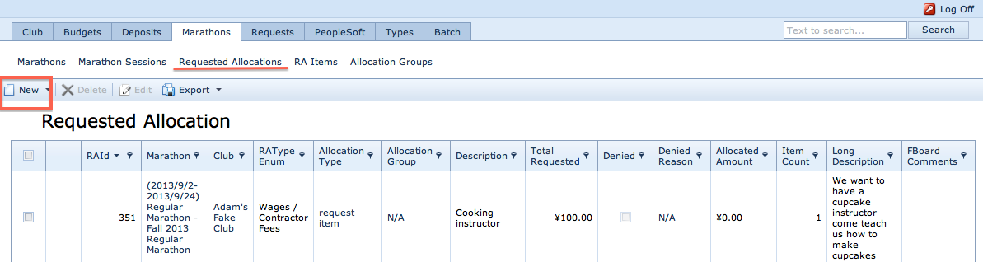
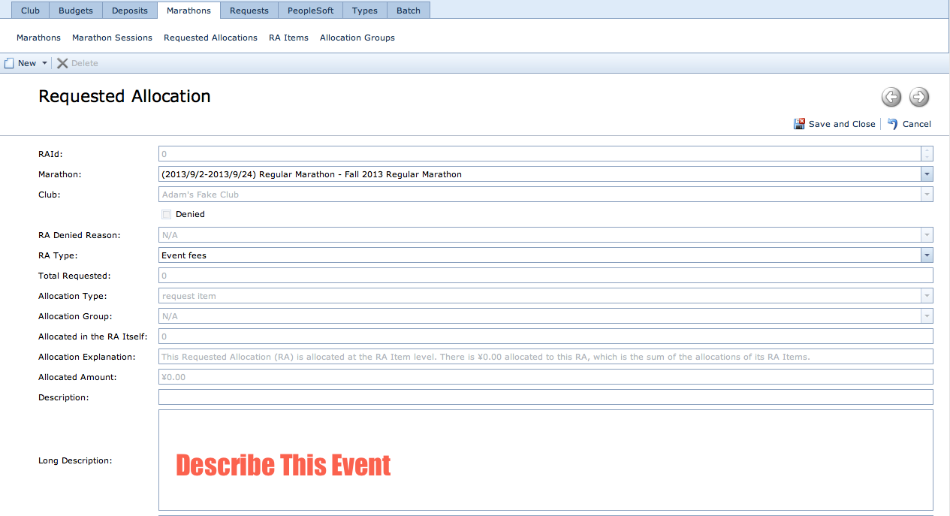
CREATING A REQUEST
Click “Marathons” Tab >> “Requested Allocations” subtab >> “New”
Marathon: Select the marathon you’re applying in
RA Type: Event fees, Materials/Supplies, Wages/Contractor Fees, Other
Description: Name of event
Long Description: Describe the event
Click “Save and close”
Notes:
Event Fees-If you have a CES invoice
Example: Custodial, police, food from SODEXO, noise permits…
Wages/Contractor-If you have someone providing a type of labor service
Example: Speakers, bands, DJs, instructors, coaches
Materials/Supplies-Stuff
Example: food (not from Sodexo), plates, crayons, books, cooking materials… basically any physical stuff
Other-
Travel, league fees, tickets, printing/publication fees

Slide 21
RA Types
Event Fees: For CES costs
Wages/Contractor: For labor services
Materials/Supplies: Physical objects
Other: Miscellaneous fees
Notes:
Event Fees-If you have a CES invoice
Example: Custodial, police, food from SODEXO, noise permits…
Wages/Contractor-If you have someone providing a type of labor service
Example: Speakers, bands, DJs, instructors, coaches
Materials/Supplies-Stuff
Example: food (not from Sodexo), plates, crayons, books, cooking materials… basically any physical stuff
Other-
Travel, league fees, tickets, printing/publication fees

Slide 22
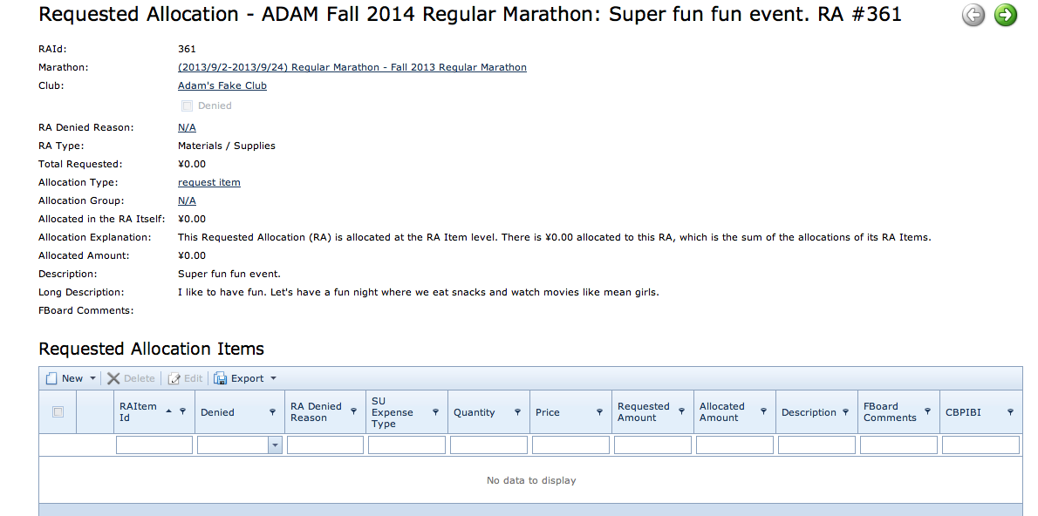
REQUESTING ITEMS
To request items within RA, click “New.”
If not within that RA of an event, a new RA should be created

Slide 23
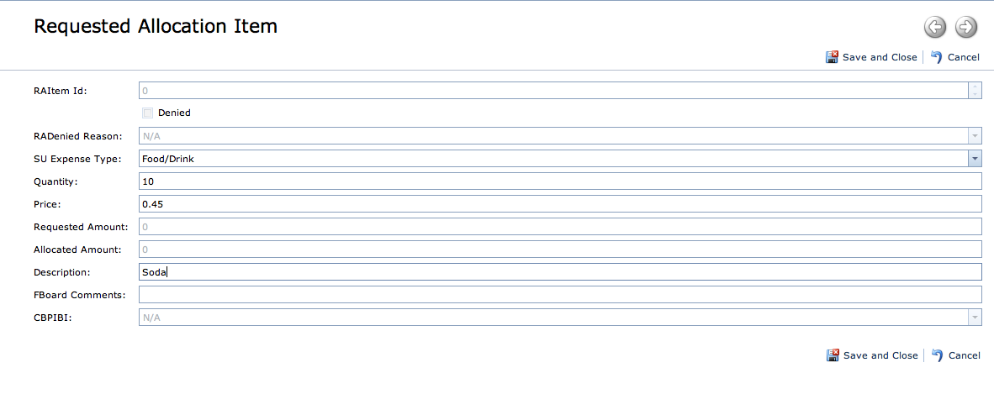
REQUESTING ITEMS (continued)
SU Expense Type: Choose the best category
Quantity, Price (per item), Description
Save and Close!!!!!
Tip: You can add as many Request Items as you want if they are under the same type of request (e.g. food, drink, utensils)

Slide 24
TIPS
Take advantage of campus resources: equipment from SU/SA, grants from ICC/Ethics Center/BPA
Be specific!
How many people?
Location? If location requires fee to book, justify cost.
Where are prices from? (at least 2 vendors; competitive / cost-effective; Google Maps / invoices )
How is this integral to your club’s mission?
The more information you give, the more likely we are to allocate. We will be generous if you are prepared! ☺☺☺
Notes:
Rentals from SU/SA:
6’ tables
3’ x 3’ tables
Projectors
Coffee/hot chocolate makers (up to 90 people)
Walkie-talkies
Stereos
Microphones (wireless and wired)
Popcorn machine

Slide 25

WHO TO CONTACT?
Questions about allocations? Not sure of something in our funding policy? Please contact clubfinance@brandeis.edu or come to our office hours (TBA)!

